Slide 1
Supportive Slides from Computer Networks
By Tanenbaum and Wetherall

Slide 2
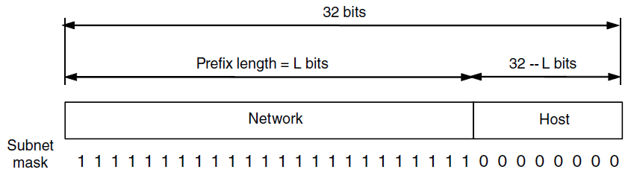
IP Addresses (1)
IP addresses are written in dotted decimal notation like 128.208.2.51
An IP prefix.

Slide 3
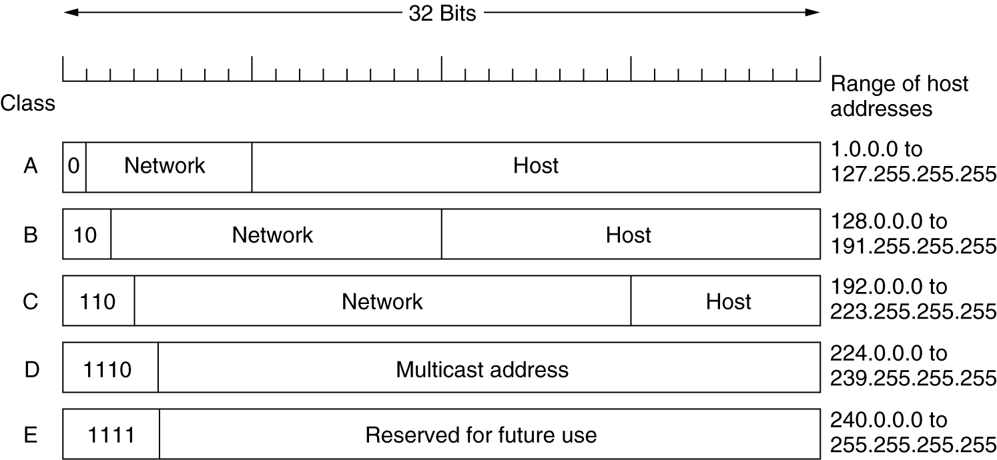
IP Addresses
A: 128 networks with 16 million hosts
B: 16384 networks with 64K hosts
C: 2 million networks with 256 hosts
IP address formats.

Slide 4
Subnets
Hard to put all hosts on a single network.
Soln: Split a network into smaller parts (subnets) for internal use which still acts like a single network to the outside world
Subnetting is not visible outside the network.

Slide 5
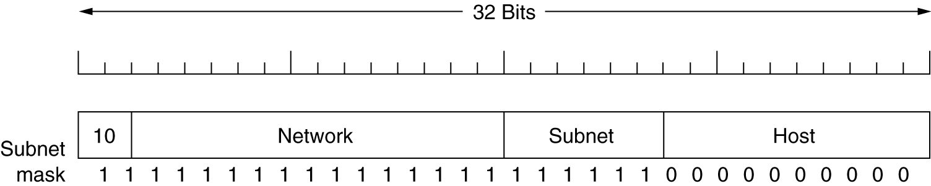
Subnets
Host number in the IP packet is partitioned into (subnet+host)
Ex: A class B network subnetted
into 64 subnets.

Slide 6
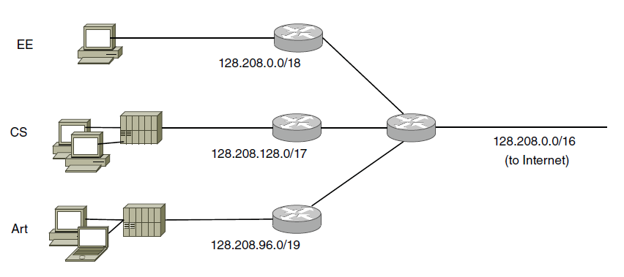
IP Addresses (2)
Splitting an IP prefix into separate networks with subnetting.
Outside the network, subnetting is not visible.

Slide 7
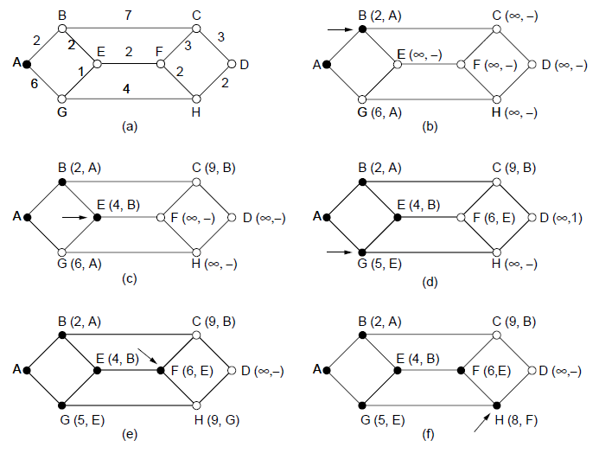
Shortest Path Algorithm (1)
The first five steps used in computing the shortest path from A to D. The arrows indicate the working node

Slide 8
Flooding (Taşkın)
Every incoming packet is sent out on every outgoing link except the one it arrived on
It generates vast number of duplicate packets
A hop counter is kept at the header of each packet which is decremented at each hop, with the packet being discarded when the counter reaches to zero
Keeping track of floooding packet could be an alternative technique to avoid sending them out second time
Selective flooding could be another alternative solution
It is very robust
It finds the shortest path

Slide 9
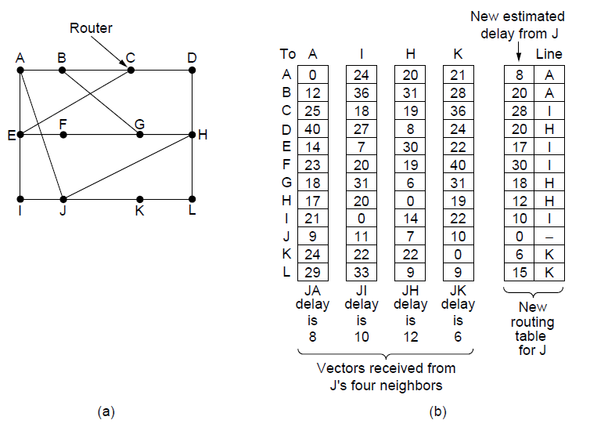
Distance Vector Routing
(a) A network. (b) Input from A, I, H, K, and the new routing table for J.

Slide 10
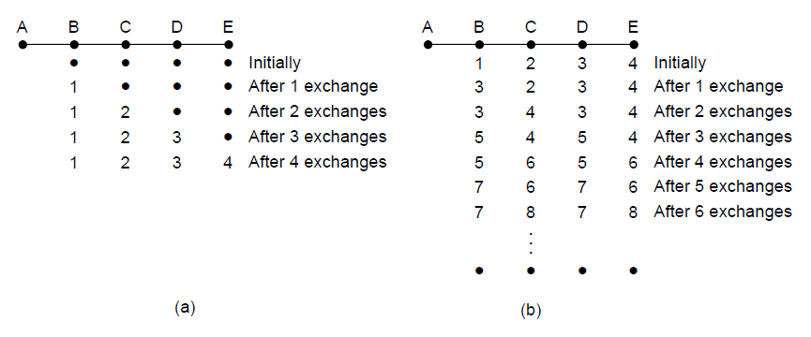
The Count-to-Infinity Problem
The core of the problem is that when X tells Y that it has a path somewhere, Y has no way of knowing whether it itself is on the path.
The count-to-infinity problem

Slide 11
Link State Routing
Discover neighbors, learn network addresses.
Set distance/cost metric to each neighbor.
Construct packet telling all learned.
Send packet to, receive packets from other routers.
Compute shortest path to every other router.

Slide 12
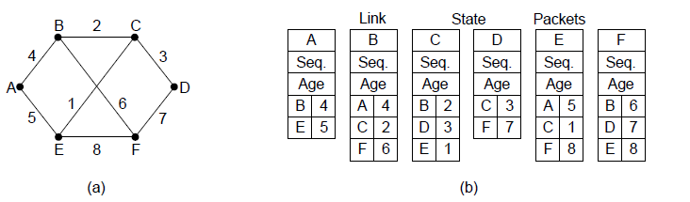
Building Link State Packets
(a) A network. (b) The link state packets for this network.

Slide 13
Possible problems
Sequence numbers wrap around
If a router crashes, it will start with seq no 0!
If a sequence number gets corrupted
Solution: Age field which is decremented once per second while being kept in a router. If it gets zero, the packet will be discarded.
+ Some refinements: holding area and ACK

Slide 14
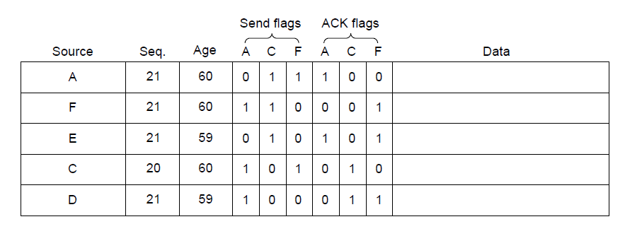
Distributing the Link State Packets
The packet buffer for router B in previous slide

